Slide 1
Applying Machine Learning to Predict Maize Traits Using SNP Data
2018.3.17
Chen Xupeng
Notes:
Hello everyone, its my honor to give you a predentation about my project, applying machine leanring to predict maize traits using SNP data.

Slide 2
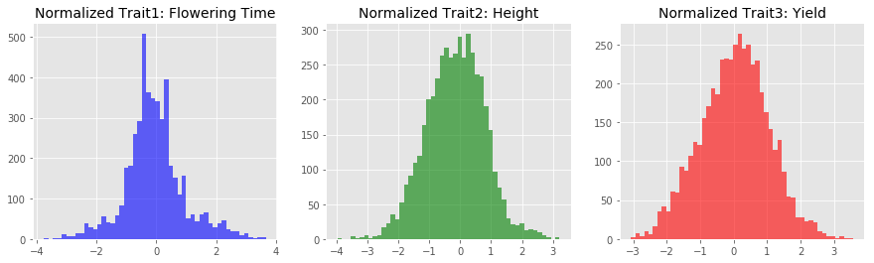
Heterosis and quantitative traits prediction
Improved function of biological quality in a hybrid offspring.
Outyield conventional cultivars & respond better to fertilizer.
Predicting maize’s quantitative traits including flowering time, height and yield.
Notes:
Heterosis means that hybrid offspring can have improved biological quality than its parents.
Modern corn (maize) hybrids substantially outyield conventional cultivars & respond better to fertilizer.
Computational methods including machine learning is useful in predicting quantitative traits including flowering time, heright and yield. It can reduce the field expeiments time and money expense. Also it may be helpful in finding heterosis.
The data shown below is three quantitative traits after normalization.
We would like to develop some computational model including machine learning, which is mostly data driven, to use genomic data including SNP to predict traits. In machine learning field people always want their statistical model use as few prior knowledge as possible. In this project I also do some purely computational work, but during the research I also include some biological thinking and breeding knowledge
Homozygote heterozygote
to try to predict traits better and find the heterosis

Slide 3
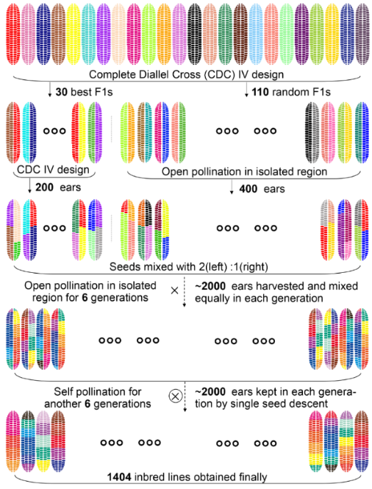

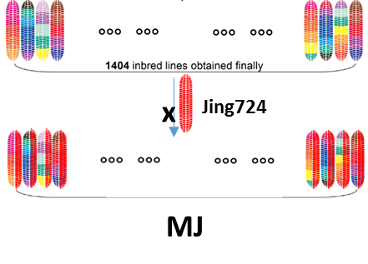
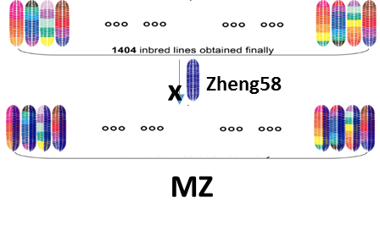
Project design
30 elite inbred lines
NCII design with 6000 hybrids
First stage: Training and Test on 30*207 hybrids
Second stage: Predict on 36,000 hybrids and test on 2408 hybrids
200 random lines
Potential 36000 hybrids
cross with Jing724
1204 lines
cross with Zheng58
Testcross population with 2800 hybrids
Notes:
The project is designed as follows ,first we will use hybrid samples from 30 inbred line cross with 207 inbred lines. We do training and test on these samples to develop a model to predict traits well. And on the second stage we have more data, we will also test the results on another 1204 inbred lines cross with two elite inbred lines.

Slide 4
Data Summary
Now:
6210 hybrids:
SNP data. New preprocess. 5.88M
Traits: DTT, PH, EW
30+1404 parents:
SNP data: 5.88M
Traits: DTT, PH, EW
Environment data:
5 locations’ hybrids and parents traits
Future:
All 30*1404 hybrid:
SNP data
Whole genome data
Environment condition data
RNA-seq:
Parents
hybrid
SNP: Single Nucleotide Polymorphism, the information of nucleotide can be converted by one hot coding
Notes:
Here is a brief summary of the data, now we have 6210 hybrids SNP data,each sample has 5.88 million snp loci, three traits data, and all parents SNP and traits data, also we have 5 locations hybrids and parents traits data. Later we will get all hybrids SNP data and whole genoe data , environment condition data and rna-seq data.

Slide 5
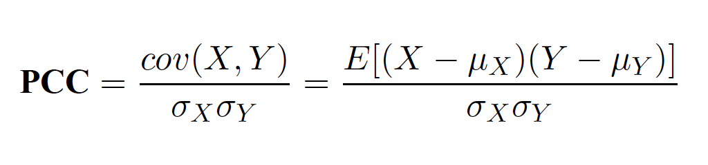
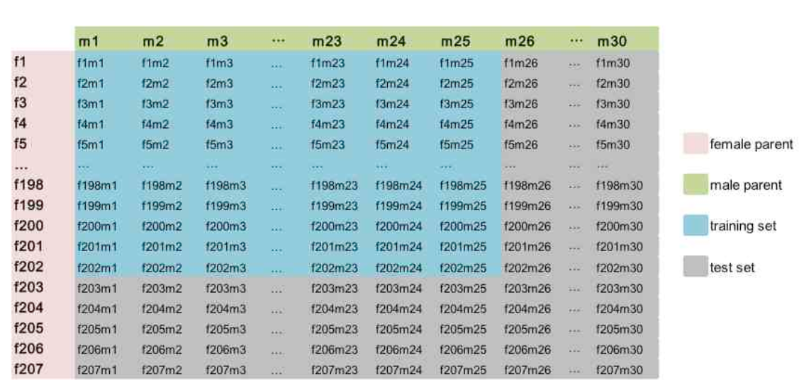
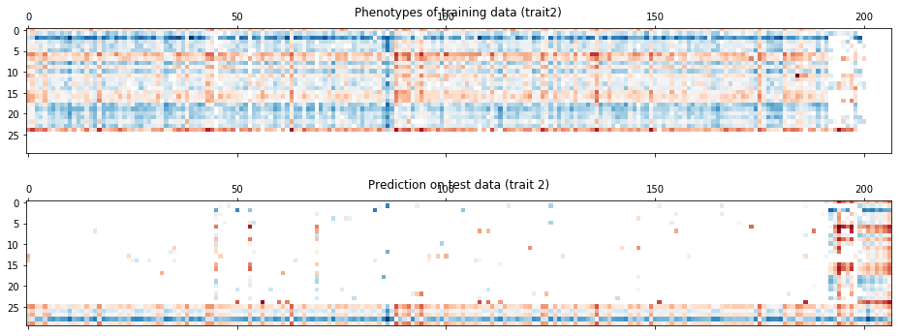
Evaluation Metric and Dataset Splitting
Evaluation Metric:
Training dataset
Test dataset
Notes:
For regression model’s predicting result, we often use pearsonr correlation to evaluate
A special splitting method turns out to catch and focus on the crucial point of the problem. It immediately reveals the overfitting problems of common mahine learning models

Slide 6
Overfitting of Machine Learning model
Feature selection: ANOVA, Random Projection
Regression model:
Ridge (kernel), Lasso, Random Forest, XGBoost
K-nearest neighbor, Support Vector Regression (SVR)
Gaussian Process Regression and Multi Layer Perceptron (MLP).
Overfitting:
10-fold cross validation on training set has high PCC with best model(>0.9)
Low PCC on test set (0.5~0.6)
Key point:
The model predict traits by learning relationship of samples (infer parents)
Random sampling leads to high validation PCC, but fails to predict on samples distantly related to training set.
Notes:
For the feature is really huge in this project: over a million feature in each sample, many feature selection method has long computational time, so we use a modified anova(analysis of variance) algorithm to speed up computation speed tens of times. Random projection is a linear transformation which is similar to PCA and SVD but has many benefits(doesn’t have dimension restriction and computation efficiency, J-L Lemma ensure the error of high dimension to low dimension converision in a small range).

Slide 7
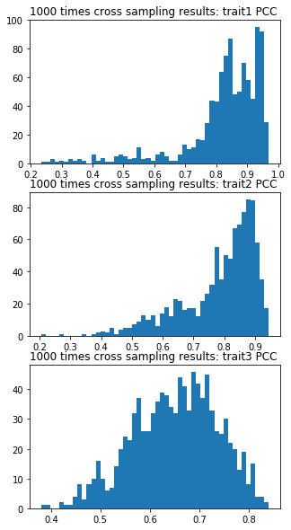
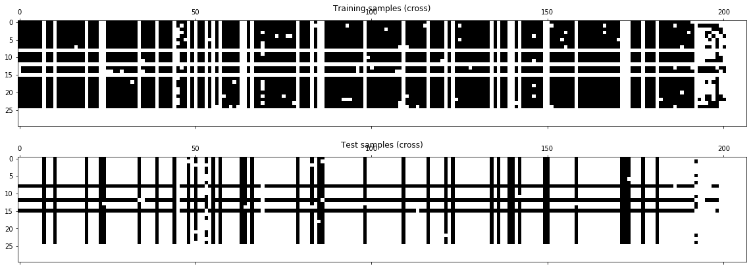
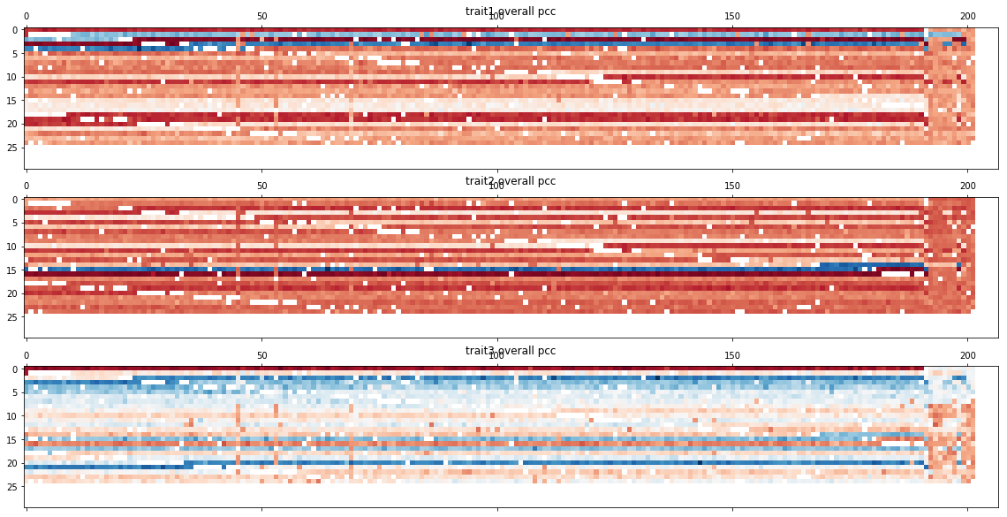
Large scale test simulation reveals relationship
Split dataset by cross sampling
Each round’s PCC distribution
Notes:
Now we know that ordinary random sampling in machine learning problem isn’t suitable for this problem, we have to test the model using cross sampling to evaluate its performance on samples whose parents aren’t included in training set
But a large scale training and test simulation(about 1000 times) using random projection and gaussian process regression shows that the poor perfomance model get a good average results. On previous specific test set(the last five male and last 5 female,)the prediction is very hard, PCC is only 0.5~0.6, but 1000 times simulation has average PCC over 0.8
We can see in the left bottom plot, we can see each row has same parents and traits are dominated by male, and most of the male’s hybrid is easy to predict, only a few’s hybrid is hard to predict. The previous test set happens to be the hard to predict males.
It seems that the model get a high pcc in average, but it stills fails to solve the problem, actually the model only performs well because these samples have close relationships, but we can see there are some males have distant relationship, and the model performs badly. And we aim to develop a model purely rely on SNP data to predict, but the model doesn’t learn that much, under their own training criterion, they only learn to deduce their parents traits, so if we have a distant related sample, or in the future a sample which has totally different parents from this dataset, the model obviously will perform badly.

Slide 8
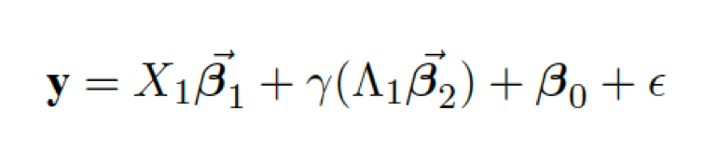
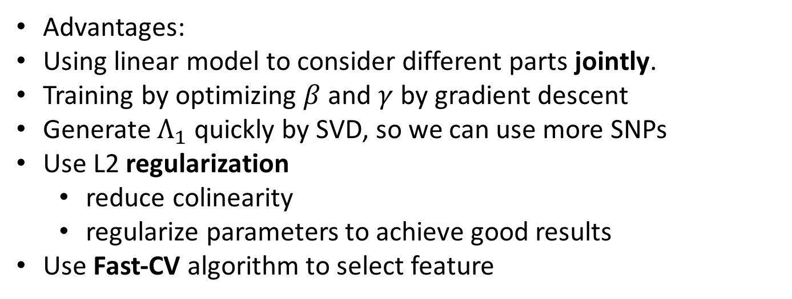
Mixed-Ridge Model
Two parts: based on genetic similarity to predict traits and based on traits-correlated SNPs(causal SNPs) to predict traits
Advantages:
Using linear model to consider different parts jointly.
Training by optimizing $β$ and $γ$ by gradient descent
Generate $Λ_{1}$ quickly by SVD, so we can use more SNPs
Use L2 regularization
reduce colinearity
regularize parameters to achieve good results
Use Fast-CV algorithm to select feature
Notes:
I partially solve the problem by using a mixed linear model, but it still has many problems, here I will introduce the model design very briefly.
The common model only learns the genetic similarity, that is only deduce the parents and rely on relationships. So it seems we have to make the model consider some significantly correlated SNPs as feature too, so the model will not only rely on relastionship deduction. And if we pick up the SNPs correctly, we can predict better on all samples
Y is traits to predict, X1 is the significantly SNPs selected from millions of SNPs, by experience it is usually no larger than one thousand, but it is really hard to pick.
It is one of the hyper parameter we have to select.
\Lambda is from a serios of linear transformation and matrix decomposition, at first we can use random projection or totally randomly select one hundred thousand SNPs to represent genetic similarity. The previous model actually only learn from this part. then we do SVD to generate much lower dimension matrix and filter by thresold, then after some decomposition and muliplication we get lambda1 to evaluate similarity.
The mixed-ridge model not only considers the joint effect of similarity and causal SNPs, also it has many designs to help to predict, the model is optiimzed by gradient descent or by grid search, the model use l2 regularization to avoid colinearity and regularize parameters, it is why the model is called ridge, and since the data of the problem is really huge, it is really difficult to do large scale search for X1, that is the causal SNPs, since it is a hyperparameter , it can’t be automaticly optimized by model, we have to select it manually. so another design is added. We develop a fast cross validation algorithm to do large scale cross sampling and training very fast.
U1是高于某个阈值的U中的奇异值（0.1）
U1是从6210列的U中选取的前270列，dimension of U1 is 100,000 * 270.

Slide 9
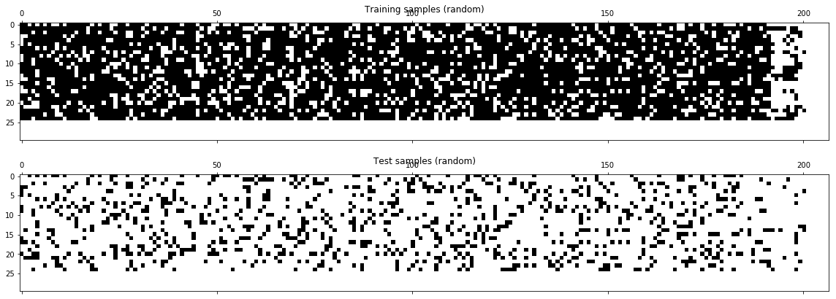
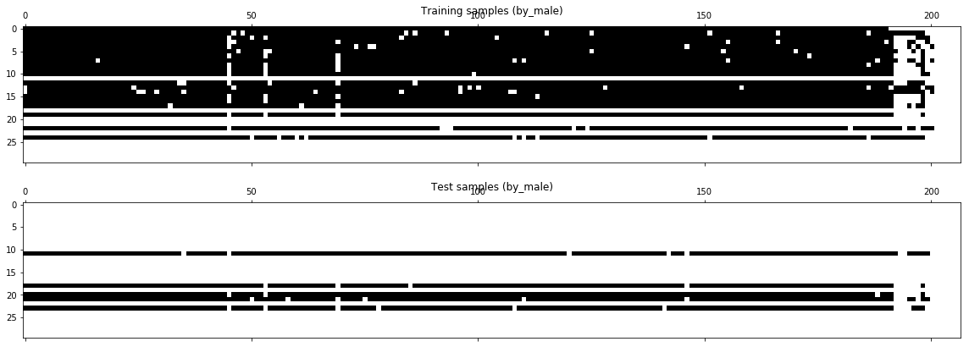
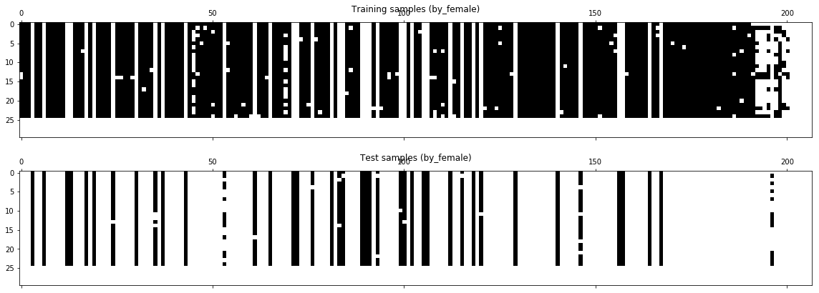
FaST CV: do cross validation quickly
Previous CV: Model should fit the data each fold
FaST-CV: No matter how many folds, only fits once
The novel algorithm Increase efficiency hundreds of time
random
By male
Cross sample
By female
Notes:
We have talked about the problem of searching causal SNPs, and a specially designed cross validation method comes to help. If you are familiar with machine learning, you may know for each fold in 10-fold cross validation, the model must train on the dataset because the training data are different each time. But we have to search the SNPs in a large scale, and we want to do cross validation more than ten fold for each SNP set. So we develop a method to train only once, not 25 times, and immediately we can have all the 25 folds cross validation results without further fitting. It speed up our computation hundreds of times. And we have talked about the specialty of our datasets, so we don’t use random sampling for cross validation ,we use cross sampling and sampling by male to test SNPs.
几乎没有一个模型注意到这样的问题：就是模型最终会在整个训练集上训练一次，但是对于我们的问题很容易出现过拟合，最终的模型我们也应该按照特殊的划分方式来调整参数和选feature，
但是因为数据量的庞大，交叉验证特别慢，我们需要快速的交叉验证来提高效率，因此我们开发了特殊的交叉验证方法，这是我们的一个理论创新。
我们可以采取多种不同的抽样方法进行交叉验证
分别是random 根据父本、母本、十字交叉，图里展示了随机抽样和十字交叉两种抽样方式
因为FaST CV的原理推导十分复杂，就不在这里具体介绍了，简单来解释是这样的：普通的交叉验证时，每一折都要在不同的训练集上拟合，每次拟合都需要很多时间，导致我们没法做大规模的交叉验证，我们通过原理的推导，针对线性模型的特性，设计了一种方法，模型只需要在全部训练集上拟合一次，然后通过告诉模型不同的抽样方式，模型会很快地计算出来拟合的结果，这样折数不管有多少，时间几乎没有增加。这是因为线性模型，每个样本对系数beta的贡献是线性相加的，我们可以分开考虑每个样本的贡献，因此使得方法可行。

Slide 10
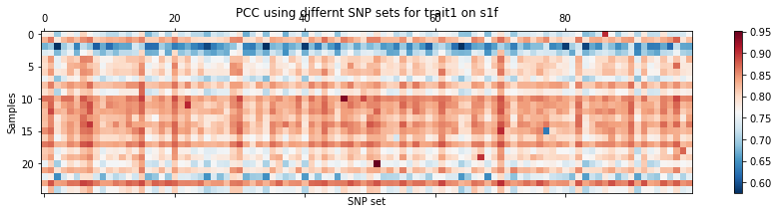
Each round do 25-fold cross validation on SNP
Change methods: optimize the worst PCC
Notes:
Because of time limitation I do not show the procedure of the whole algorithm with fast cv method. Here is the selecting procedure of causal SNPs, each round we select one set of SNPs and optimize the model. Each column stands for PCC in 25 cross validation. Previously I use median number of 25 PCC to compare and select the best one. But recently I realized, since most of male’s hybrids are easy to predict, we can not use median or average to evaluate, but should compare the worst pcc, and also should increase folds of cross valiation to test as many different male combination as possible
对每一次挑选的SNP、$γ、λ$进行25-fold cross validation
只需要两分钟即可做一个SNP选择的交叉验证（即做两百次25折交叉验证），且可以多组SNP并行进行
大规模搜索的SNP的PCC
以s1f为例，每一列是一种SNP set，每一行是一次交叉验证，分别算PCC，我们试过对每个SNP set，用不同的PCC的统计量去挑，比如平均值，中位数等等。现在我们来审视我们的问题，一是时间有限，我们本来不应该随机选这么少的SNP，而且由于训练集很容易就找到一组好的SNP，但是在测试集很难表现好，所以我们应该改成PCC在很多折中的最小值也比较高的feature组合，就像蓝色的区域，是不好预测的样本，我们的最终的完美模型应该是能把这些地方也预测好的才行。
普通的机器学习模型严重依赖于已有的样本的亲本信息，Mixed-Ridge经过前面的分析可以看出来可以避免样本的相关性不良影响且可以利用相关性提高预测效果。
对于全新的样本，可以通过简单的变化来产生Mixed-Ridge 模型需要的Lambda，然后再预测

Slide 11
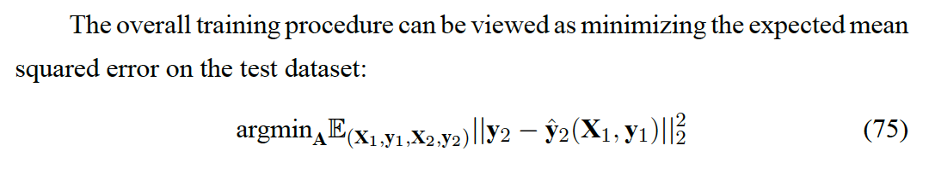
Metric Regressor:
Notes:
I will go over this part very quickly for it is not a very mature model
alought this problem has more samples than before, it is still a small sample problem in machine learning area. Also you can see that most of samples are not very useful for it is very easy to predict because of samples correlation, it may even be harmful for the model easily stop training because major parts of the data make PCC become high very easily.
So inspired by a small sample learning method(in deep learning it is called one shot of small shot learning problem), another model is designed to solve the problem. I will omit the provement and tell you that it is a non parametric model so it will avoid overfitting. It also use some sparse transformation method to reduce dimension.
I will skip over the algorithm and operation details, you can see that the training and test data share the seem parameter theta,, and use least square to get beta, then use MSE as loss function and optimize by gradient descent, we have many options thanks to deep learning area’s optimization method. Then the operation will be repeated to produce the result.
It seems very promising in solving small sample problems, but the model has a very fatal fault, it has high computational complexity! Different from discrete classification problem, the regression problem has continuous value, and the easiest least square and its derivitives calculation still consumes many resouces because it is very difficult to calculate inverse of matrix. So it restrict us to use samples no larger than 100. so in principle it is harder for regression problem to optimize. Since the parameter search scale is really large, a slow algorithm will be abonded. But I still don’t give up for there maybe some methods to convert continous value to discrete and doesn’t loss so much precision. But it still need more consideration before applying it.

Slide 12
Improve Feature Selection
Use LD decay curve to divide region, select SNP from each region.
Use clustering method. (If complexity is tolerable)
DACE(LSH + DP-means), unfixed cluster numbers.
Consider long range
GWAS (Genome-Wide Association Studies)
Common methods: consider SNP separately.
Use Mixed-Ridge and Lasso do it batch by batch
Notes:
Although I said we want to use as little prior knowledge as possible, it seems that purely computational method omitting the speciaty of breeding field prevent us to solve the problem.
So I consider some more feature selection method to try later. Including use LD decay curve to specify regions and select SNP from each region to avoid redundance.
It is already used in several fields. I also consider a better method by using clustering. This problem is harder in many process because it has millions of features and many methods are not suitable for its computation time is high. But a not very common clustering method using dirichlet process and locally sensitive hashing may solve the problem. It has high speed, the cluster numbers are unfixed which is way better than using LD region.
Also we want to use GWAS but I want to add some improvements. Commonly GWAS use some methods including some predicting models and do statistical test to determine which feature is more important. It is kind of like a loop, because the current models are not good enough, if we use these model to select feature, it may not be suitable. Actually there is no model can select SNPs good enough for all samples.

Slide 13
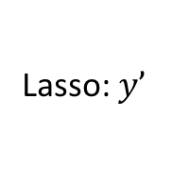
GWAS
Mixed-Ridge used as feature selection
Use Mixed-Ridge to consider feature combination
May find causal by eliminating genetic similarity
Iteration until MSE doesn’t change
Mixed-Ridge to select SNPs
Lasso: $y’$
Mixed-Ridge to select SNPs
Lasso: $y’$
Notes:
I use our mixed ridge model plus another linear model called lasso to do GWAS. Common GWAS feature selection method consider SNP seperately, but this time we will consider them jointly. Because the principle of mixed ridge assures it can eliminate genetic similarity, it may really find some causal SNPs . Each round we will do Mixed ridge on whole SNP data and do statistical test to find best top 2000( and 2000 is also a hyperparameter to optimize), and use the selected SNPs to feed in Lasso model for regression and calculate the residual of the results. Then do mixed ridge on other data, we stop iteration when MSE (of true and predict) won’t change obviously.
Also we can add more features we have collected, including parents SNPs to help feature selection and as genetic similarity measurement, Hybrid with unknown traits’ SNPs can help do unsupervised learning including clustering and calculating LD. We will also use RNA-seq data when it is available in the future.
Mixed ridge也可以用来做特征选择。
我们的mixed ridge加lasso的方法是有可能实现挑出来的都是causal的，因为它们可以消除遗传相似性
GWAS的常用方法，包括一些机器学习的方法如ANOVA和mutual information都是独立考虑每个SNP的，我们可以考虑用MR做一个将特征组合起来考虑的方法
我们先用Mixed ridge挑选一定量的特征，比如2000个，方法是做完Mixed-ridge后F检验选p-value小的feature 用这些特征输入到lasso中建立一个残差模型，lasso拥有将大多数特征的权重置为0的正则化效果，接下来再做mixed-ridge，以残差作为y挑选特征。我们的目标是通过多轮迭代，最终使得预测的y与真实的y的MSE不再变化，或者说让残差的平方均值不再变化。通过这种方式挑选特征。在这个问题里，每次挑选多少SNP，Lasso的正则化系数是超参数。

Slide 14
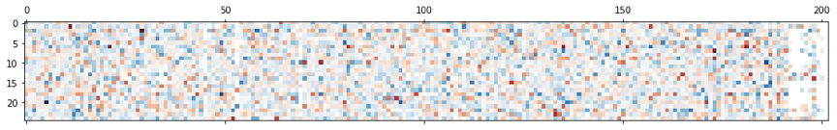
Non-Linear Model
Find heterosis
Similar ideas like Mixed-Ridge:
calculate residual of hybrids (SCA).
Multiple-Trait combined prediction
Test correlation of different traits
Multiple traits can provide more information.
A feature good for multiple traits may be important
Trait3 residual
Notes:
Previously we use linear model for its many advantages, but it seem it may not be powerful enough to achieve our goal
This time I use a linear method to subtract parents traits at first. By using parents traits as parameters we can design a regression model ,and the residual is the traits subtracted by relationship part. So it is like the mixed ridge model, now we will try to find SNPs to predict residuals good.
If we assume that we can design a model to predict residuals well, we will solve many crucial problems: first we can find heterosis, a high residual means this sample has heterosis, then it means we find the causal SNPs too. And by adding the previously subracted part we will also predict the traits value well.
But it is very difficult to predict residuals. Remember I said the common machine learning model only learns parents relationship, and I tested many machine learning models on the residual, no suprisingly, all models got a PCC close to zero, it means the model can’t do anything because it can’t find causal SNPs to predict. It loses its ability if we subtract parents traits’ part.
So my next task will be finding and designing a good machine learning model to predict residuals well, for example, I may design a model which can select different SNPs when predicting different samples, it is a little like boosting method but is harder to design.
There is another design I may use, we can jointly predicting multiple traits at same time, the combined traits will provide more information and the feature we select under this condition may be more important.
The project also has other goals, for example the samples are planted on five different places, so another task is to predict traits variance in different places, which is also useful in real world. But it will be considered after solving the current problems

Slide 15
Acknowledgement
Professor Zhi John Lu
Professor Jianbing Yan
Xuetang program
Notes:
That is the brief introduction of my current work and some future plan
And I want to thank my supervisor Zhi lu for his suggestions and instructions on this project and thank professor jianbing yan for his big data and his suggestions on the project.
Also I want to thank xuetang program for giving me an opportunity to do many interesting work freely.
And thank you for listening, any questions are welcome.

Slide 16
THANK YOU

